Slide 1
Movie Recommendation
Jaden Lin

Slide 2
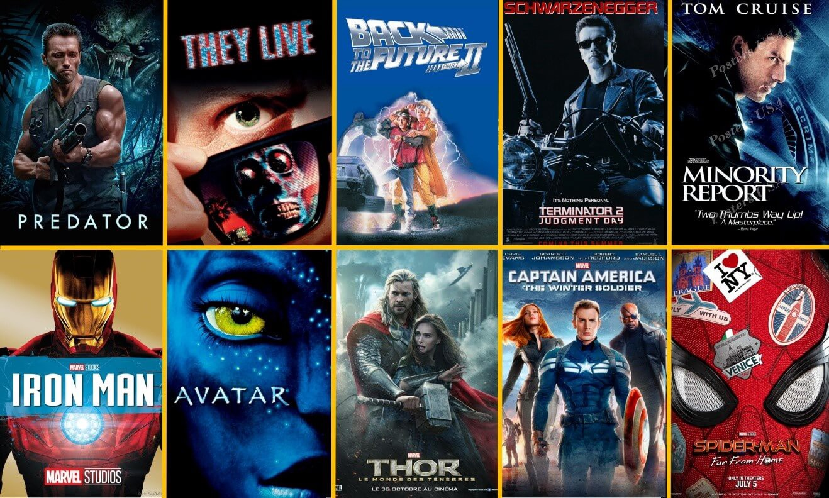
A picture is worth a thousand words

Slide 3
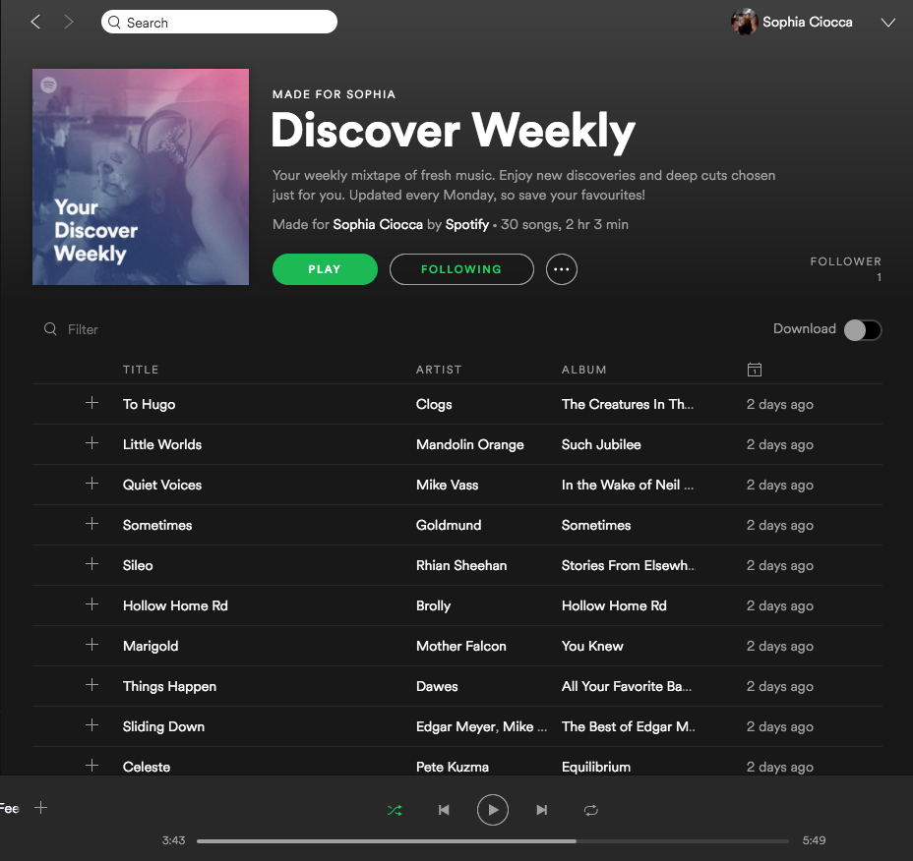
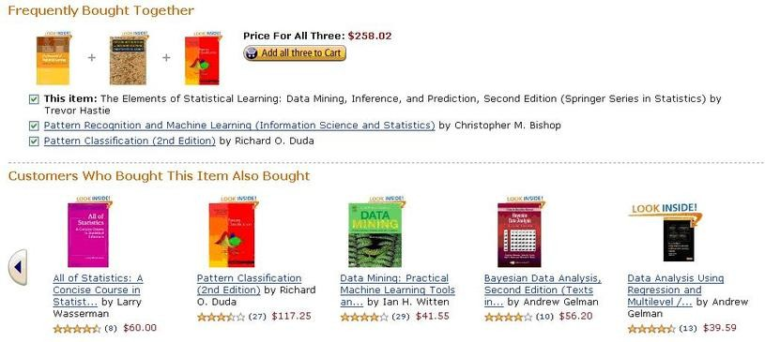

Slide 4
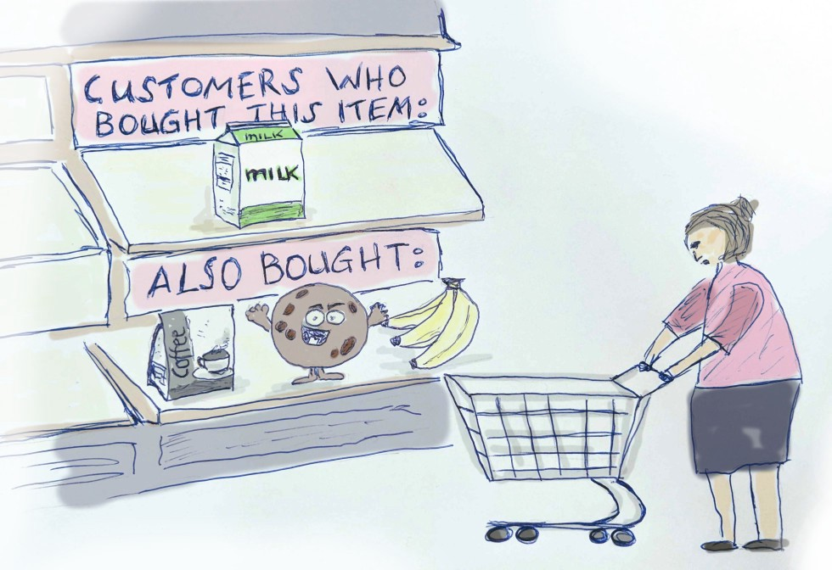
Collaborative Filtering

Slide 5





Ratings
04
?

Slide 6
Give it a try

